Slide 1
Prototype on bread board William Denson engr 491

Slide 2
Purpose
General build that is not complete – this will not serve as our standard model for the group, just my personal contribution for this week’s assignment. Found hiccups along the way documented some of my learning lessons. Some parts from the BoM do not have pin connections to the ESP32 C6; convention for which pins and input from the group is highly appreciated. Other decisions regarding the ground and miscellaneous connections are notated. The more components received (within budgetary constraints), the better the I can follow the BoM.
Several slides just show product spec sheets I found were helpful for assembly.

Slide 3
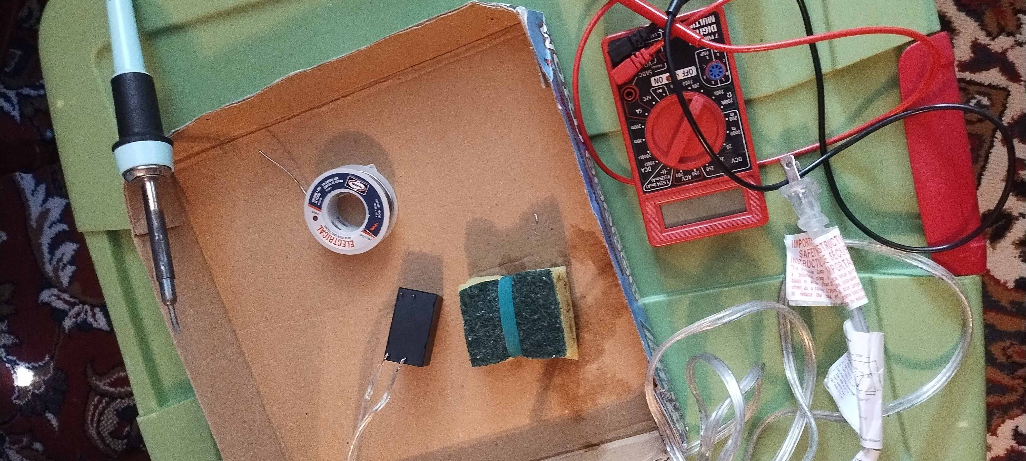
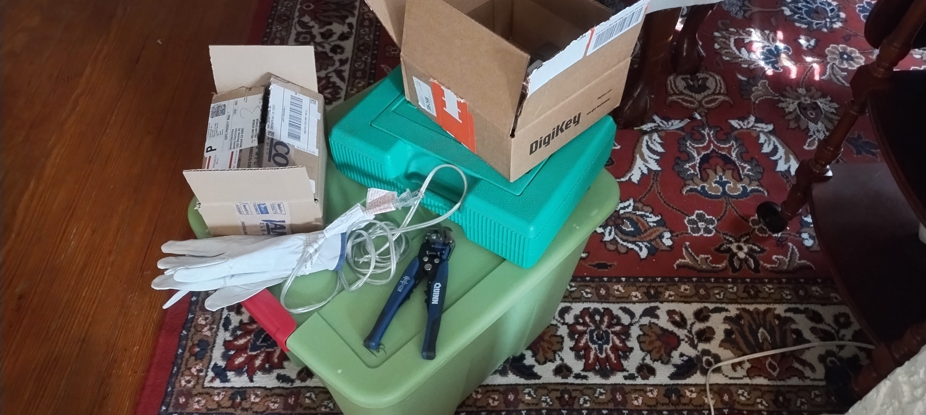
Tools

Slide 4

Soldering

Slide 5
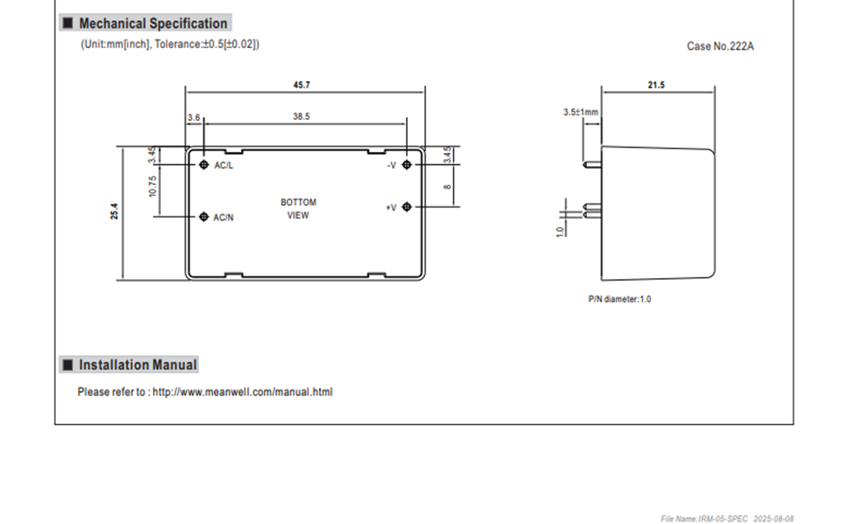
Mean Well IRM-05
Special attention to pin connections; initially thought pin layout was horizontal but don’t assume, the spec sheet has AC line/neutral on the vertical pins
Photo reference: Mean Well

Slide 6
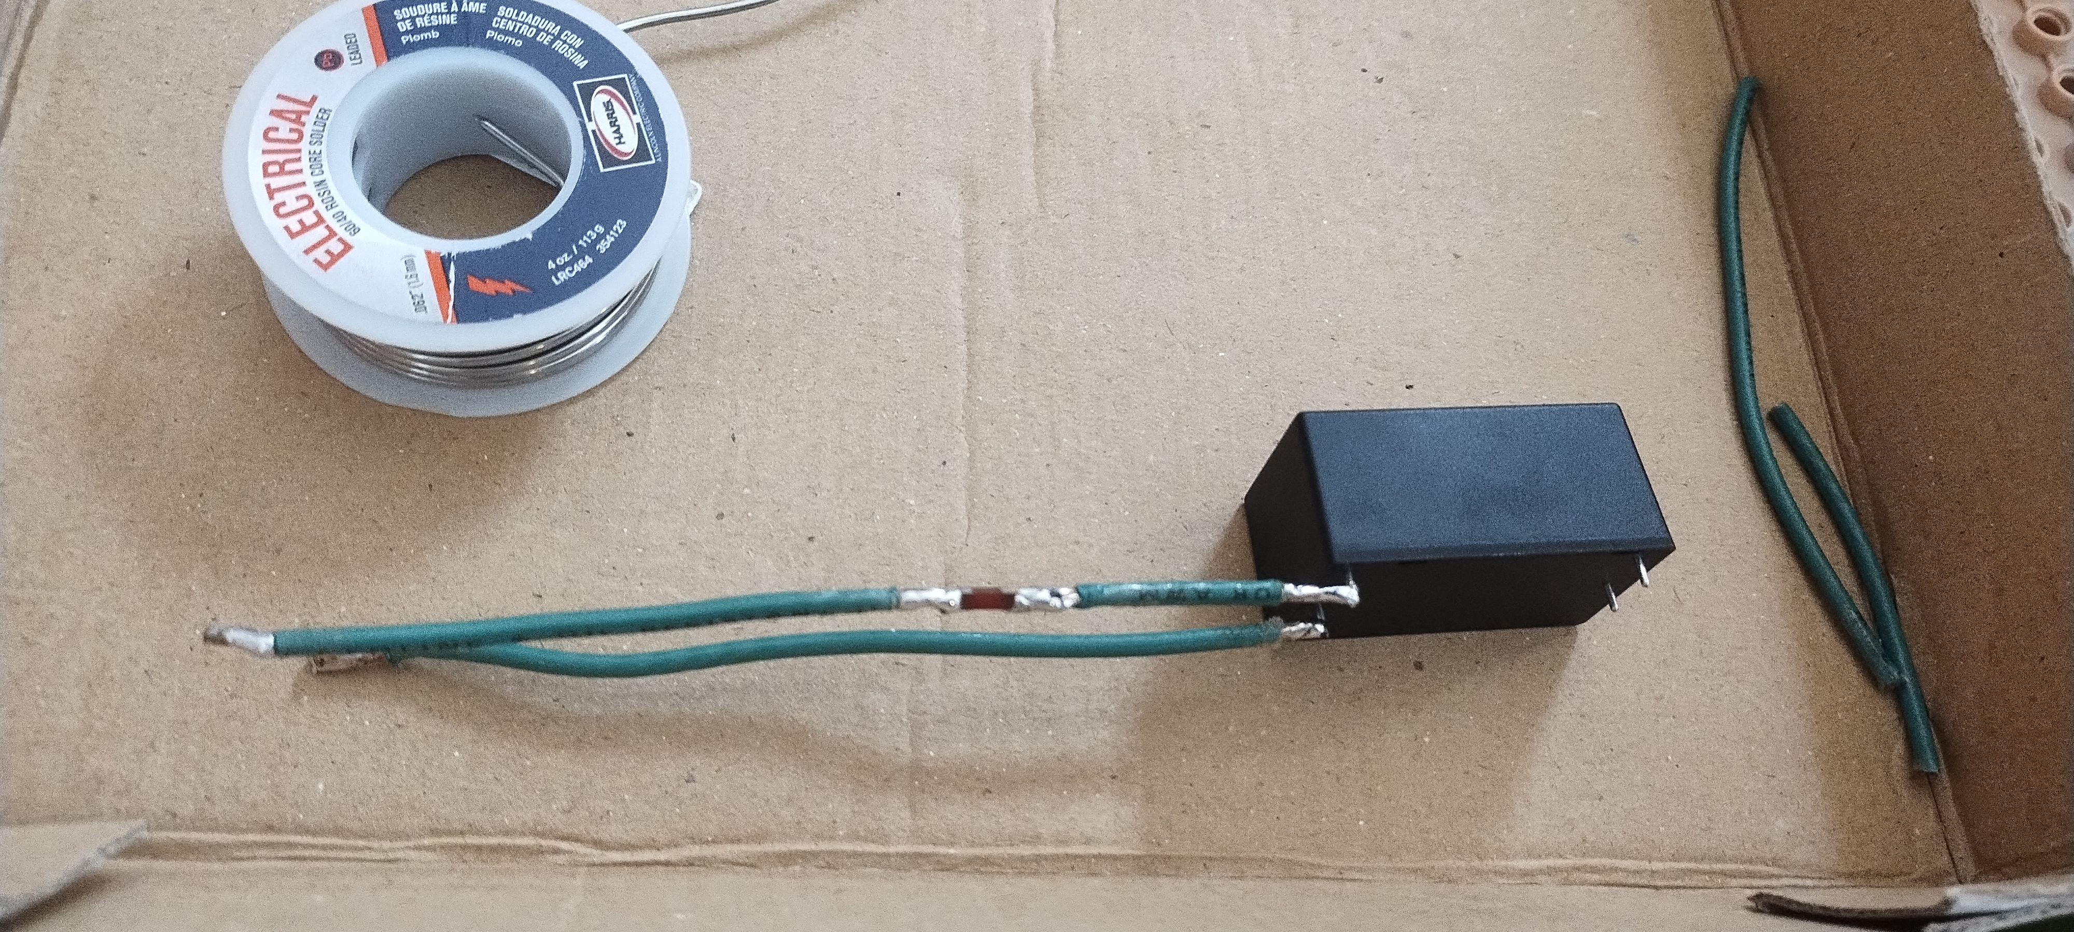
Mean Well IRM-05

Slide 7
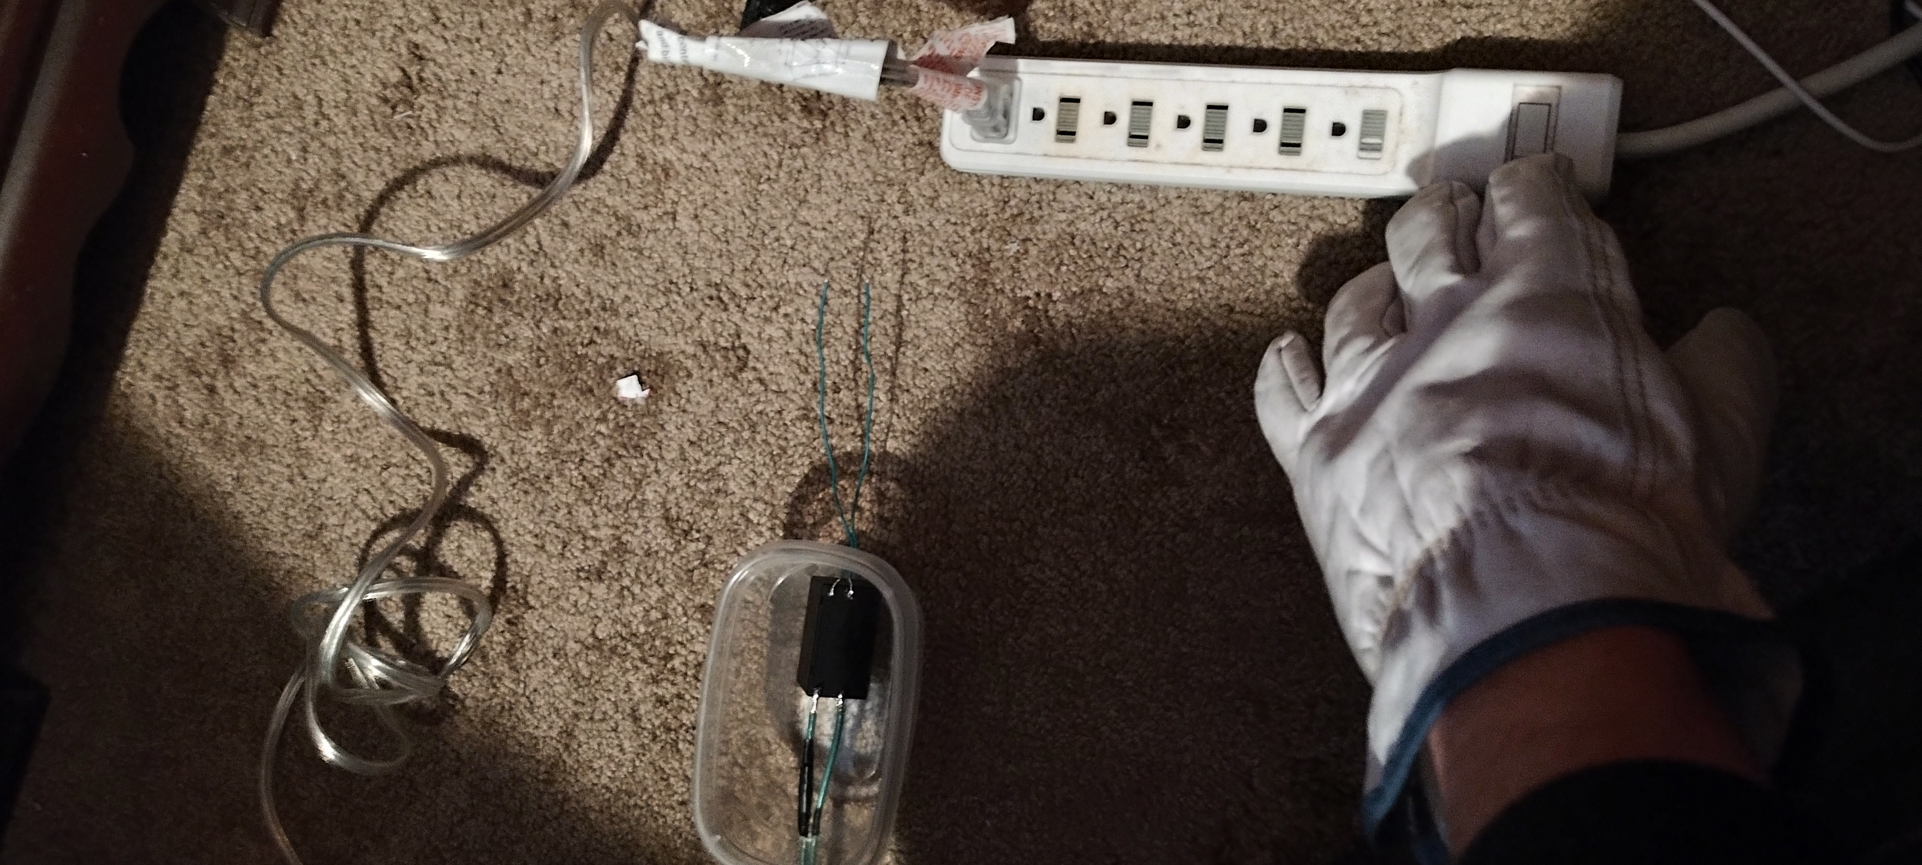
120V AC Connections
-Temporary soldered connections not including 120V lines to light bulb power
-Recommend gloves and safety glasses when testing prototype and power strip to easily turn off power
-14 gauge E51313-W Type MTW/THHN/THWN
-Stayed consistent with neutral blade being the wider of the two prongs

Slide 8
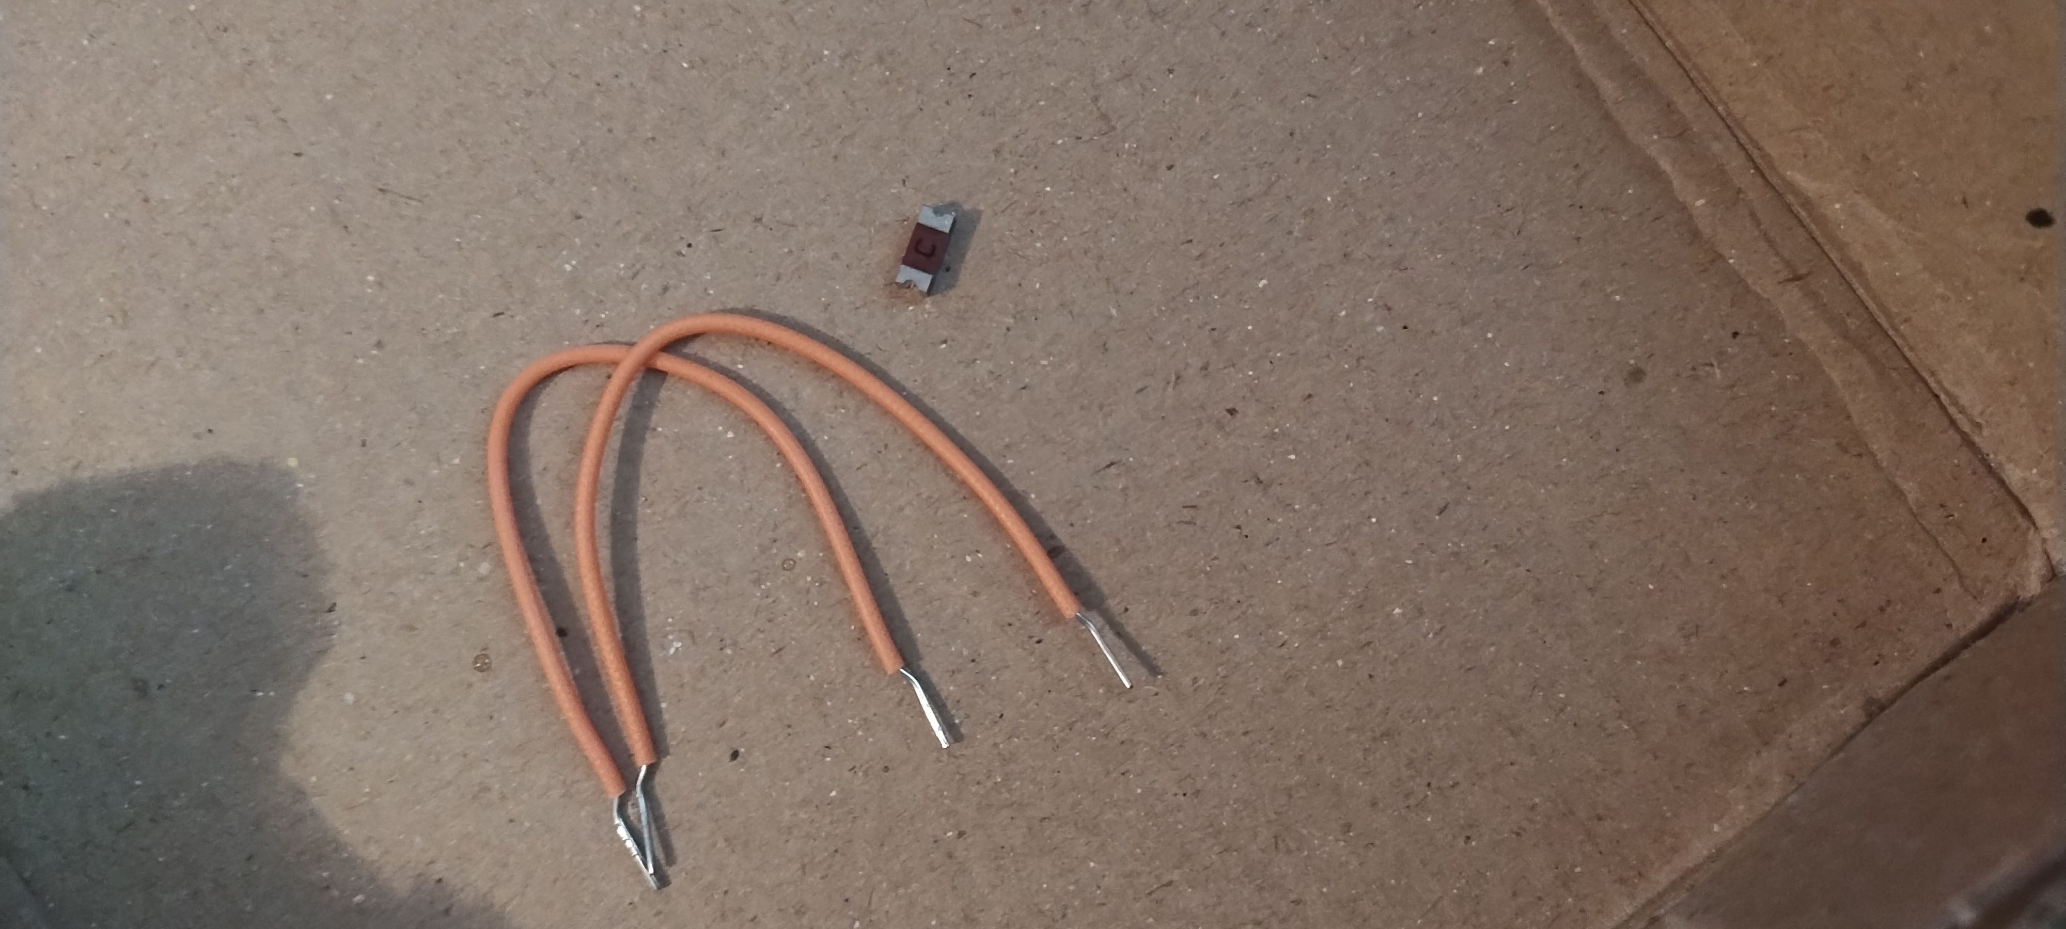
Fuse
Did not place a fuse on the neutral per NEC Section 240.22 (Classes4Contractos).
There is an alternative set up in which fuses are placed on the neutral of a device but the neutral is ultimately bonded to earth ground (Power Electronic Tips) to provide two fuses to decrease fuse failure rates.

Slide 9
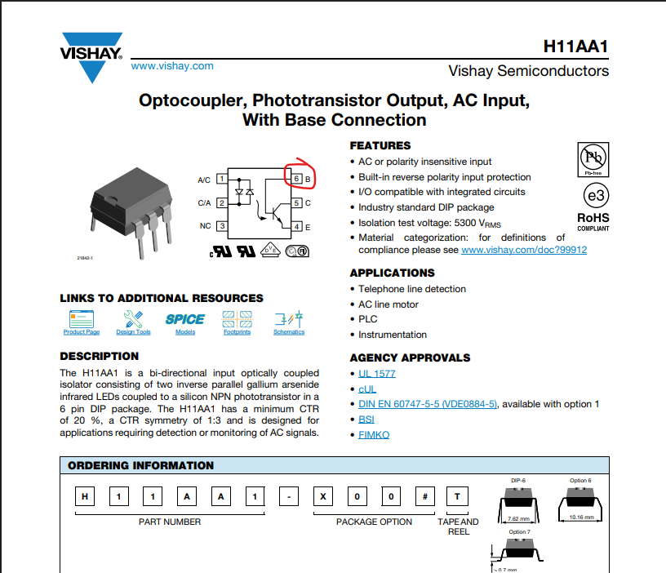
Optocoupler H11AA1
The base (#6) can be coupled with various resistors and alternative circuit routes but Alex’s schematic has it open.
Additional guidance: https://www.eevblog.com/forum/beginners/purpose-of-the-base-on-the-opto-transistor-in-an-opto-coupler/
Photo reference: https://www.vishay.com/docs/83608/83608.pdf

Slide 10
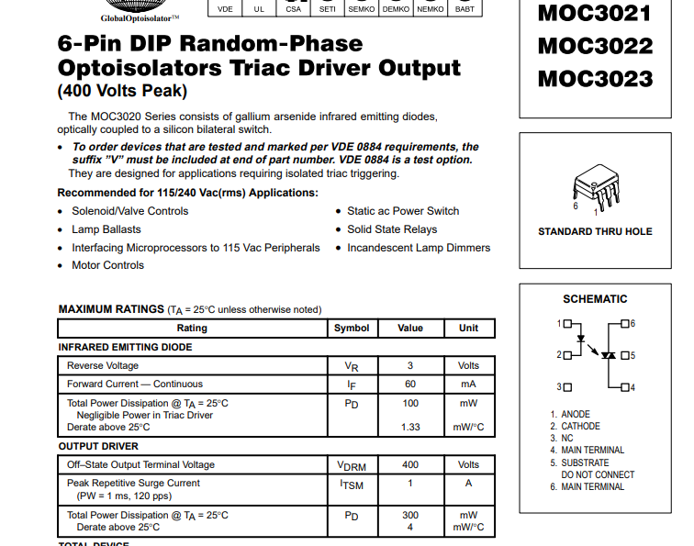
MOC3021
Photo reference:
https://www.farnell.com/datasheets/97984.pdf

Slide 11
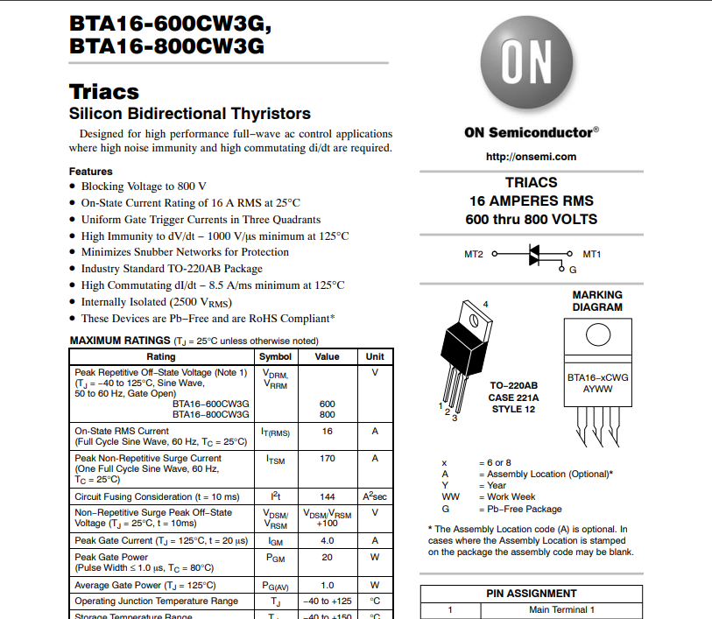
Triac BTA16-600
Photo reference:
Image credit: ON Semiconductor

Slide 12
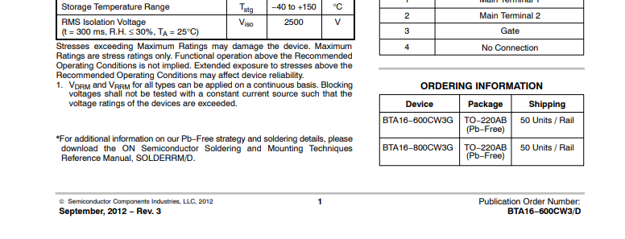
Triac BTA16-600
Photo reference:
Image credit: ON Semiconductor

Slide 13
Ground:
Ground to be off of 5V or neutral from AC mains?

Slide 14
Enclosure:
No proper enclosure utilized; used Tupperware drilled through for temporary containment. I am aware of other members of our group working on a suitable enclosure.

Slide 15
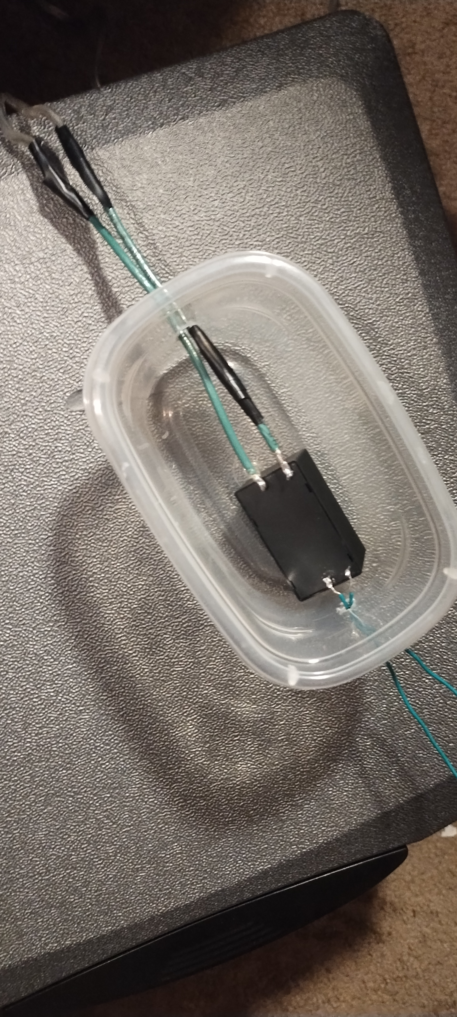
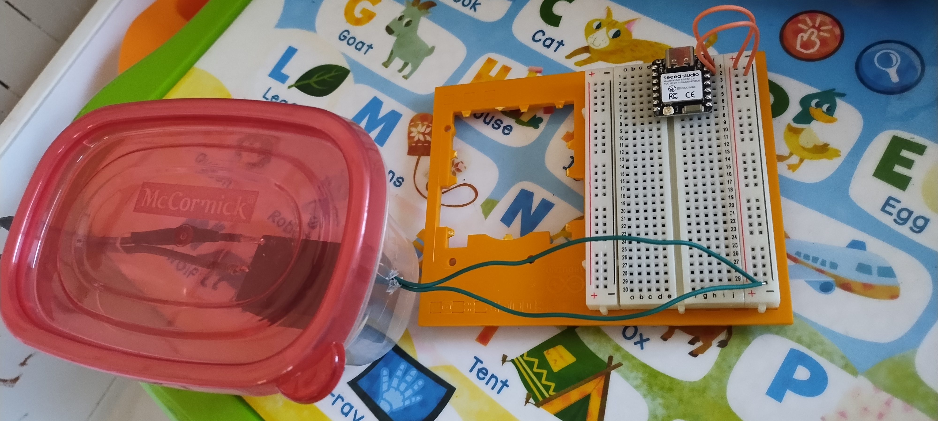
Enclosure:

Slide 16
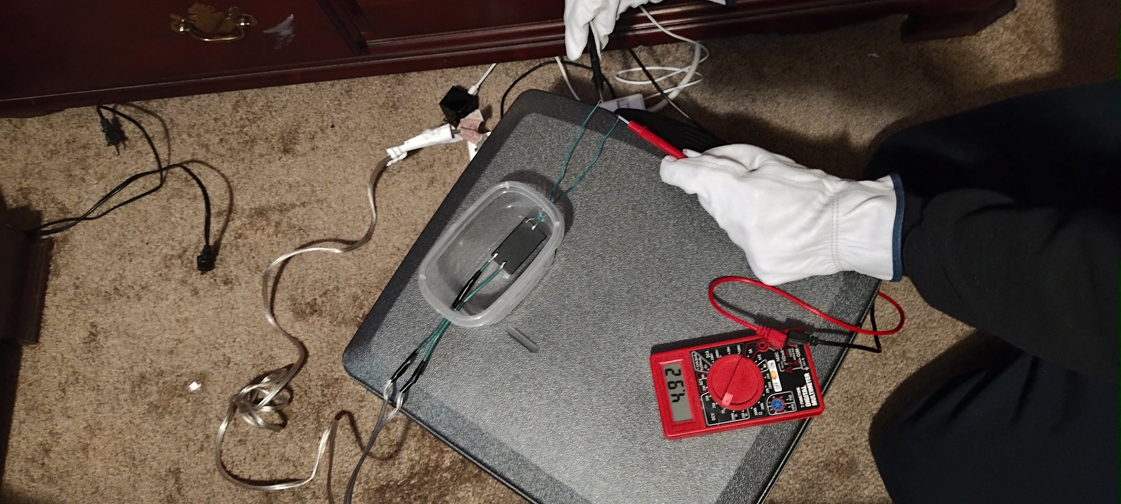
Testing:

Slide 17
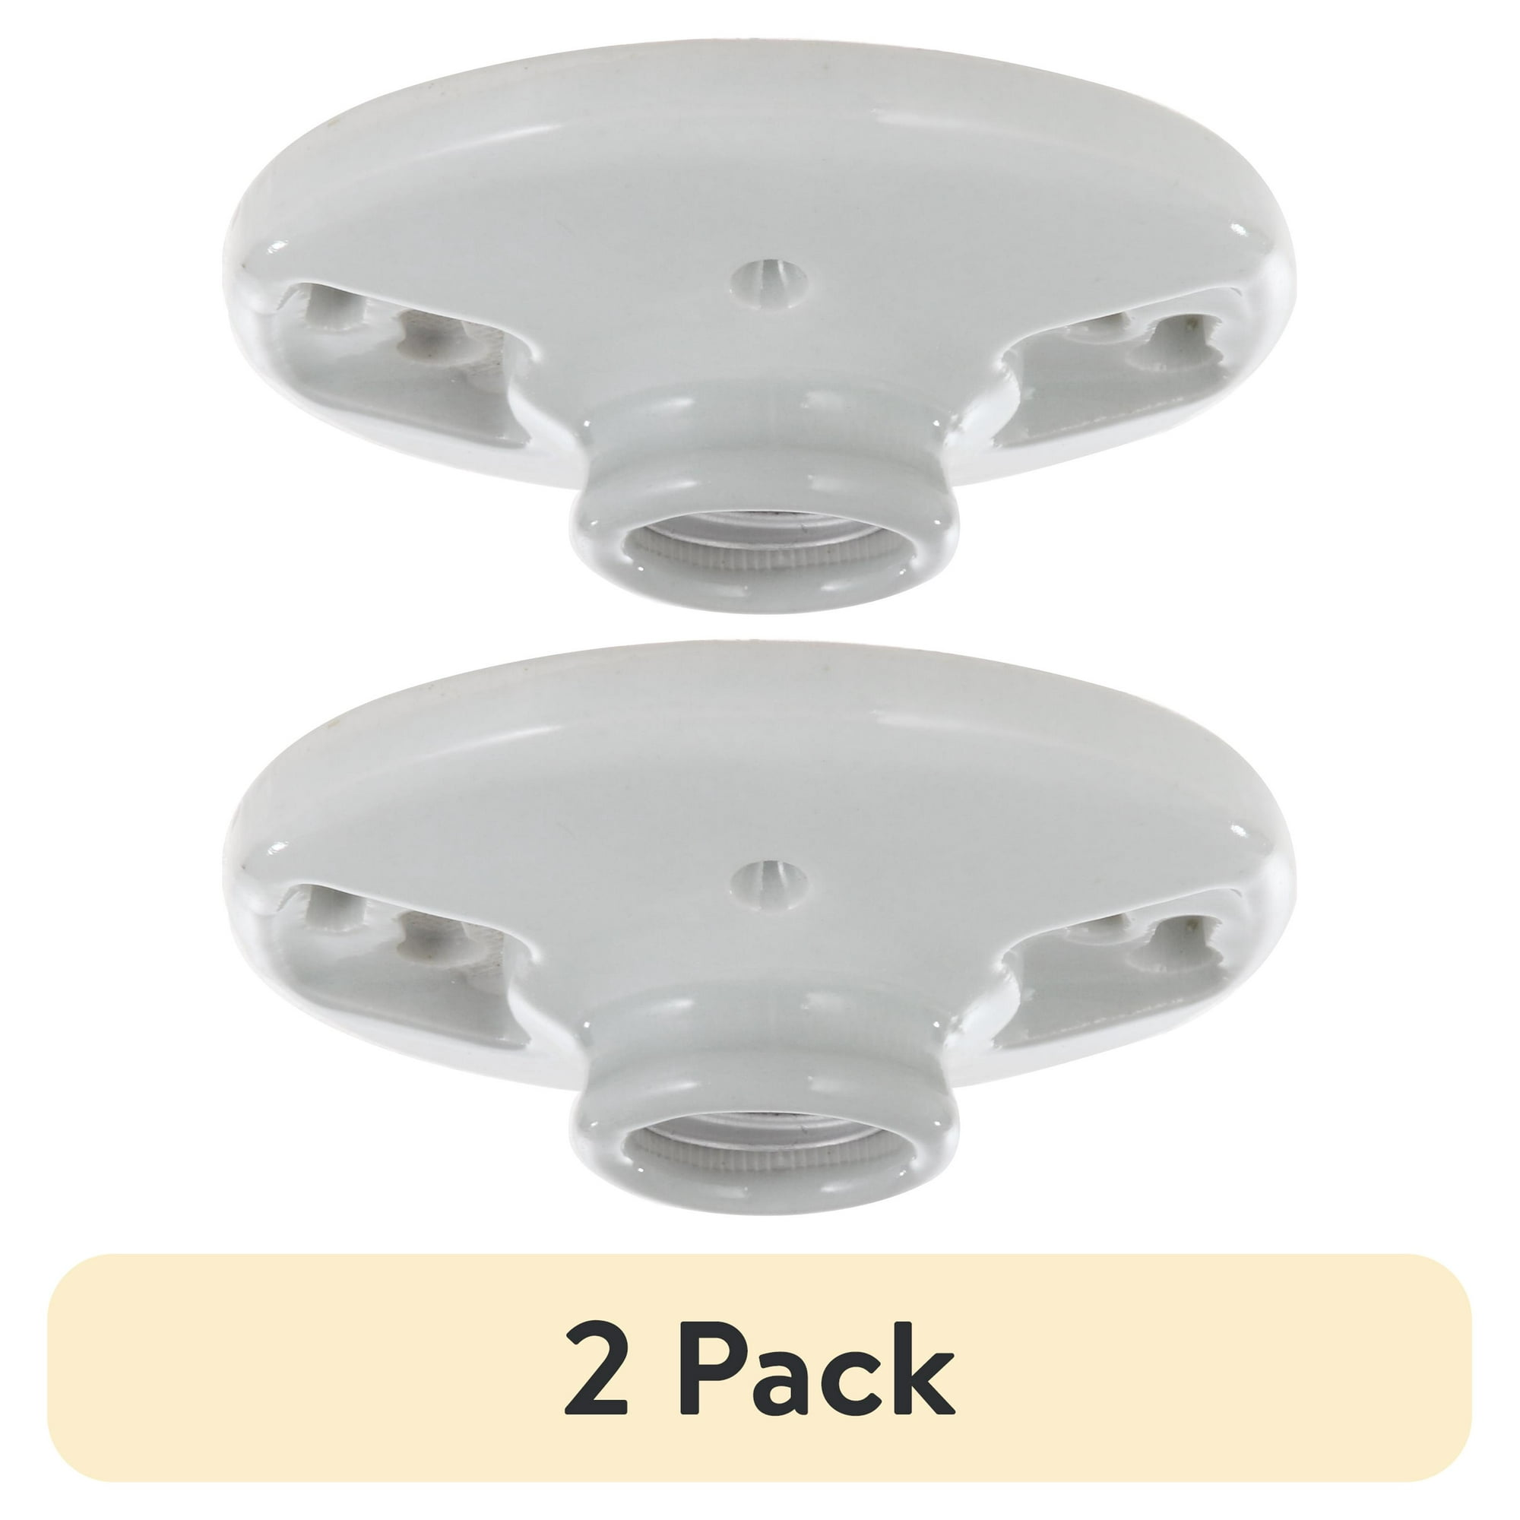
Bulb housing:
Bulb housing from repurposed lamp; more ideal alternatives can be used from a hardware store such as porcelain light bulb socket bases
Photo reference:
Walmart

Slide 18
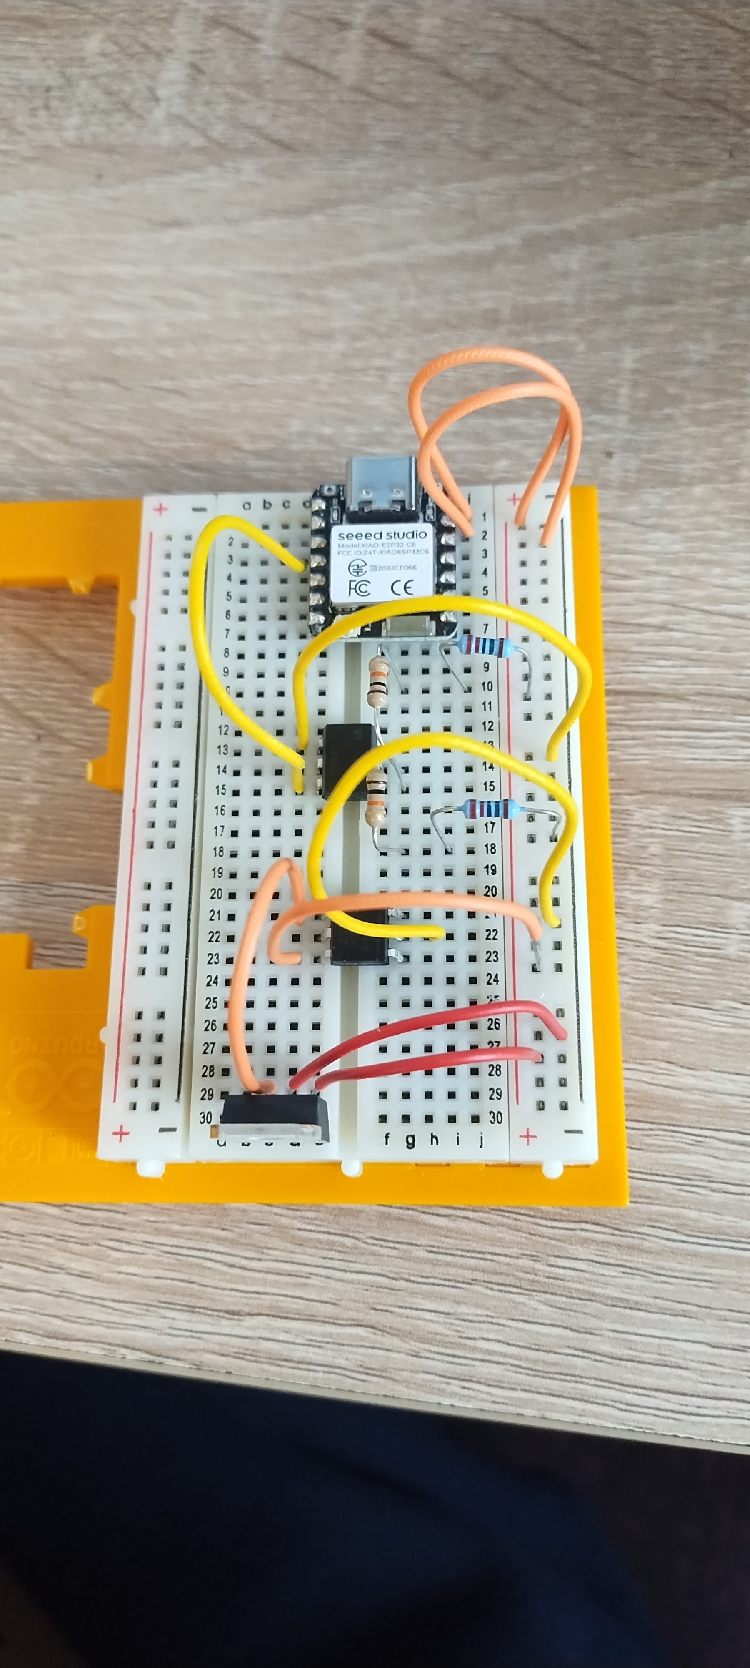
Breadboard layout:
Several components are DIP chips with gull leads that are temporarily disconnected from ESP32 ports

Slide 19
References:
https://classes4contractors.com/the-misplaces-fuse/
https://www.eevblog.com/forum/beginners/purpose-of-the-base-on-the-opto-transistor-in-an-opto-coupler/
https://www.farnell.com/datasheets/97984.pdf
https://www.farnell.com/datasheets/1708247.pdf
https://www.meanwell.com/Upload/PDF/IRM-05/IRM-05-SPEC.pdf
https://www.powerelectronictips.com/tdk-lambda-dont-fuse-the-neutral-wire-faq/
https://www.vishay.com/docs/83608/83608.pdf
https://www.walmart.com/ip/Hyper-Tough-White-Base-Porcelain-Light-Bulb-Socket-TD35078G-2-25-in-Assembled-Product-Height-1-PC/15024453460?action=SignIn&rm=true

